Slide 1
Health Information System
A simple web-based client and program management solution for healthcare providers. By github.com/RickyJMuk

Slide 2
Overview
Problem Statement: Managing clients and health programs efficiently is critical for healthcare providers to deliver quality care and track patient progress.
Solution Objectives: Develop a web-based system to manage clients, health programs, and enrollments with easy access and search capabilities.
Key Features: Client management, program management, enrollment system, REST API for integration.
Technology Stack: Node.js, Express, EJS

Slide 3
System Architecture
3-tier architecture:
Presentation Layer: EJS Views (client-form.ejs, client-list.ejs, client-profile.ejs, program-form.ejs, program-list.ejs)
Application Layer: Express Routes (defined in app.js)
Data Layer: JSON files (clients.json, programs.json)

Slide 4
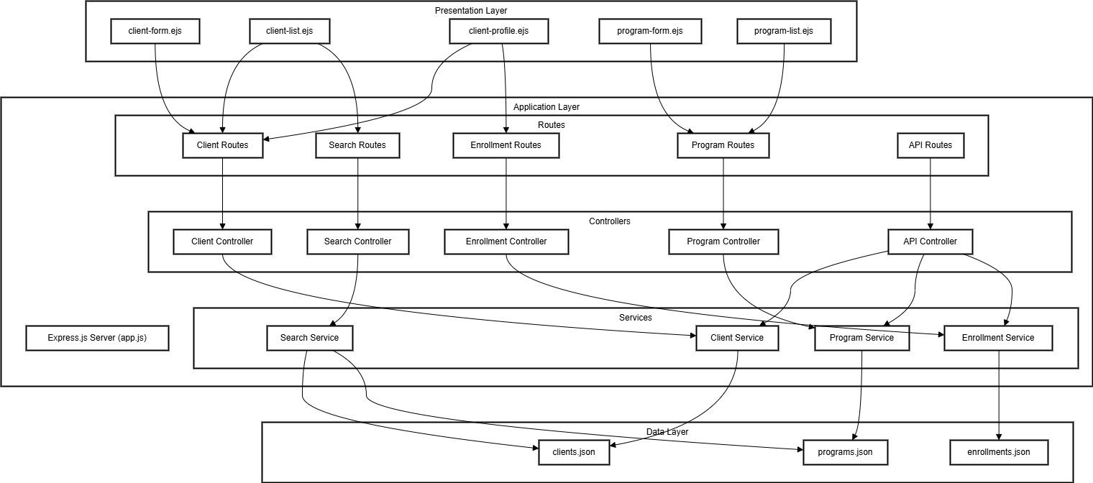
System Architecture

Slide 5
Core Features
Client Management: CRUD operations to add, view, update, and delete client information.
Program Management: Create and manage health programs.
Enrollment System: Enroll clients into programs and manage their participation.
Search Functionality: Search clients by name or phone number.
API Endpoints: REST API to access client profiles and program data.

Slide 6
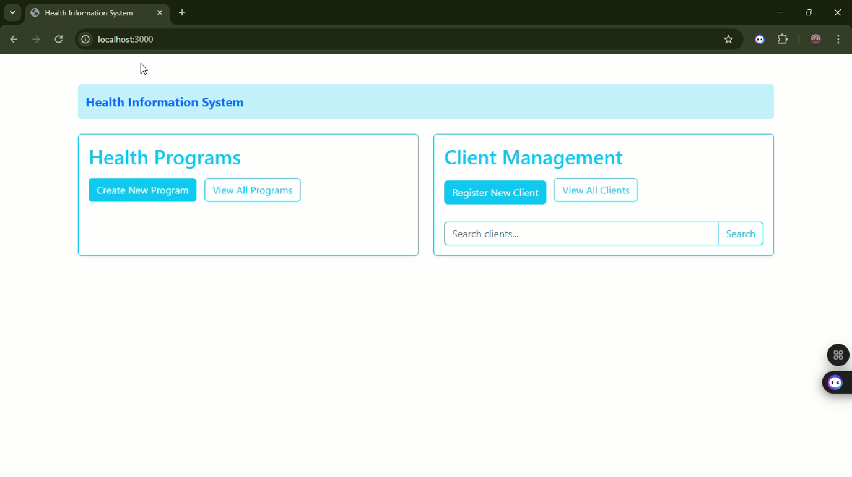
Tutorial

Slide 7
THE END

